Slide 1


SMART GATE KEEPING
AI Powered Digital Entry Management
Joseph Srujan Eda

Slide 2
Introduction
Detects vehicle type using CNN
Extracts vehicle registration number using OCR
Automatically timestamps In/Out
Stores data in spreadsheet
Digitizes complete gate records

Slide 3

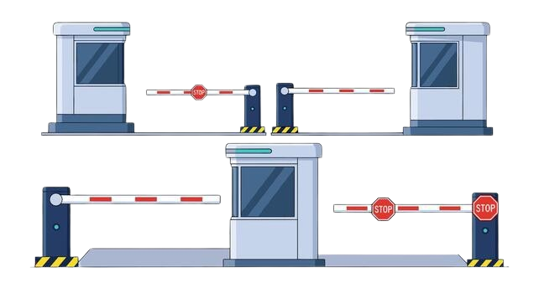
Project Architecture
Capture Image
CNN based Vehicle Type Detection
OCR based Number Plate Recognition
Spreadsheet Storage
Automatic Timestamp
Name, Reason Entry

Slide 4
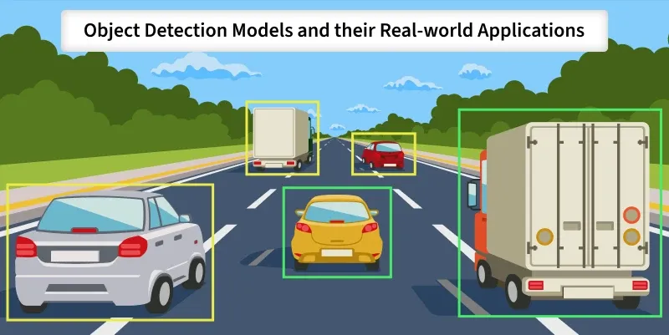
Vehicle Classification
Custom CNN trained on dataset
Dataset stored in Google Drive
Model deployed as .h5
Model directly loaded in Colab
Fast inference
Ready-to-deploy AI module
Classes: Ambulance, Auto-rickshaw, Bicycle, Bike, Bus, Car, Mini-Truck, Tractor, Truck

Slide 5
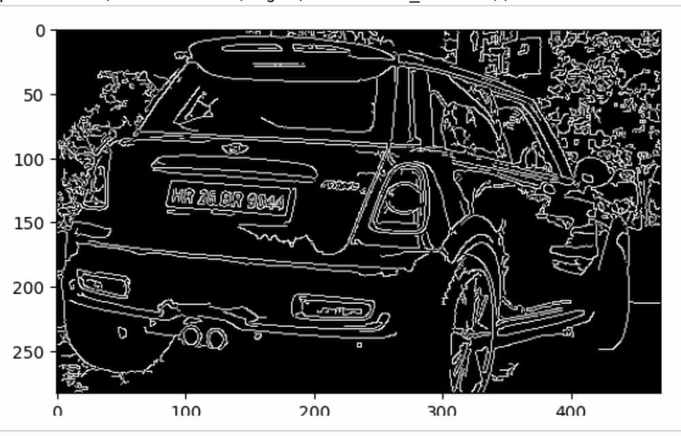
Number Plate Detection
Convert to grayscale and apply edge detection
Detect contours and filter rectangular regions (aspect ratio & size check)
Crop the most probable license plate region
Apply OCR (EasyOCR) to extract text
Clean the output (remove spaces)
Return final registration number or “No plate detected”

Slide 6
Google Colab Interface
Keeper needs to:
Capture the image
Click:✅ IN Button/ ❌ OUT Button
Enter Name of the visitor
Enter Purpose of the visit

Slide 7
Impact & Advantages
100% Digital Records
Faster Entry Processing
Reduced Human Error
AI-powered verification
Easy Data Search & Filtering
Works in real-time with deployed model
Saves time for gatekeeper

Slide 8
Thank You

